Slide 1




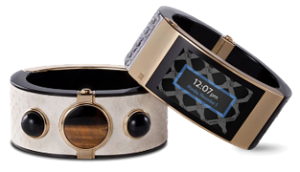
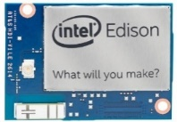
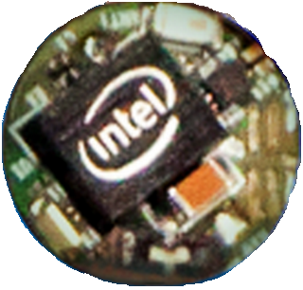
Intel® IoT & Wearable Overview
Nandkishor (Nandu) Sonar
Intel® Corporation
March-2015

Slide 2
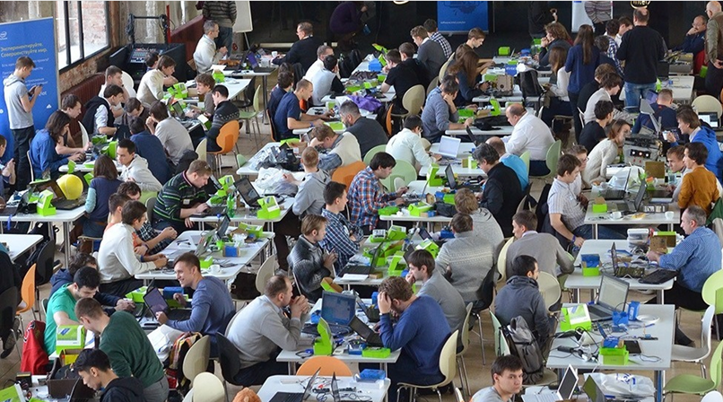
AGENDA
Intel® IoT Platforms Overview
Development environment
Libmraa & UPM libraries
Cloud Analytics overview
Hackfest kick-off
Notes:
This is what we will see in this session.
All innovative heads working on Intel IoT platforms to generate an innovative solution.

Slide 3
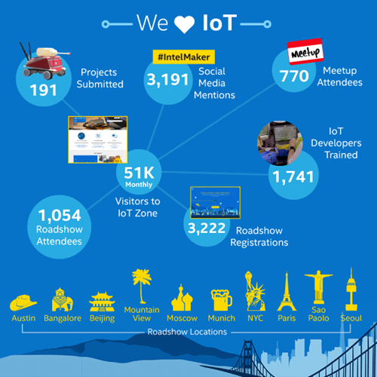
Notes:
Why we are here today?
Source - Christos Georgiopoulos email
2014 IoT review
Connected devices at 50 billion by 2020

Slide 4




Intel® Galileo and Edison™
Light Ind.
IoT
No extended temp or life
Students
Hobbyist
Maker
Pro-Maker & Entrepreneur
Consumer
IoT
Intel® Galileo and Edison Module + Derivatives
Hardware
Expansion Boards
Software
Yocto Project Poky Linux* + Various Runtimes, IDE & Developer Tools
Cloud
Developer cloud solution and partner-based solutions for scale
Support
Managed on-line community, trouble ticketing, drawings, schematics, datasheets, code libraries, webinars, etc.
Ecosystem
ISVs, Incubators, Crowd Source funders & SIs
* Names and brands may be claimed by the property of third party name and the notation.
Notes:
Source –IDF

Slide 5
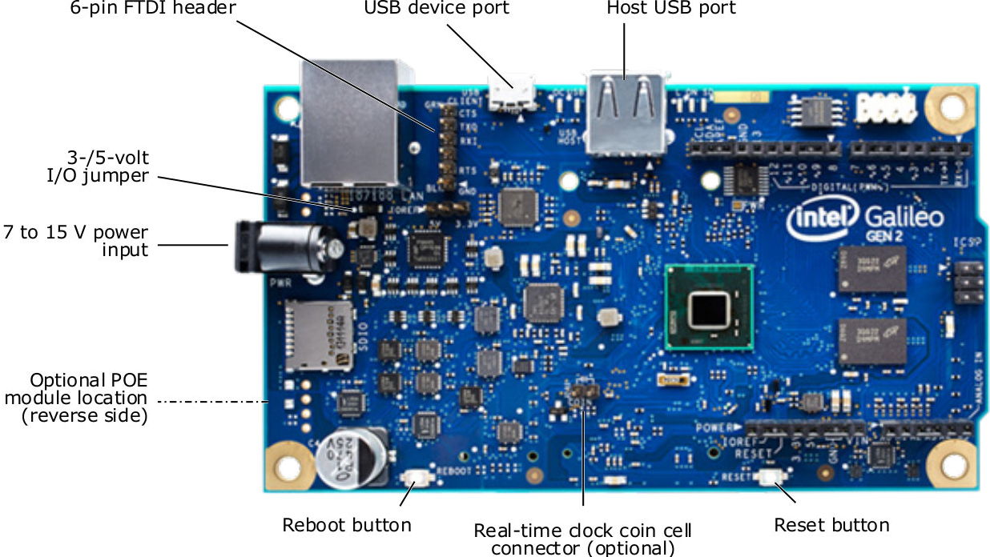
Intel Galileo Development Board
Designed for students, makers and electronics enthusiasts / hobbyist
General Embedded headless applications and Gateways
Board I/O: Compatible with Arduino Uno
20 digital I/O pins including 6 pins 10-bit PWM
6 analog inputs
2 UART (RX/TX)
1 I2C
1 ICSP 6-pin header (SPI)
USB device connector (Host)
Micro USB device connector (client)
SD Card connector
DC power jack (7V – 15V DC input)
Notes:
$70

Slide 6
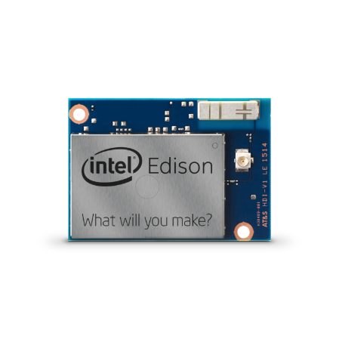
Intel Edison module
Desingened to be wireless with compute performance and low power!
For inventors, entrepreneurs, and consumer product designers to rapidly prototype.
Board
22nm 2 core Intel® Atom™ Core™ @ 500MHz
1 Intel® Quark™ MCU @ 100MHz
35.5 × 25.0 × 3.9 mm
1 GB RAM (LPDDR3, 2ch @ 800 MT/s)
4 GB eMMC
Wi-Fi (a/b/g/n) + BT 4.0 + antenna
40 GPIOs : UART, I2C, SPI, I2S, PWM, USB 2.0, SD card, clock out, GPIO
Software
Default OS: Yocto* 1.6 Linux*
Right now: 3.10.17 kernel
OTA upgradable
libmraa: IO abstraction layer
UPM: sensor libraries
* Names and brands may be claimed by the property of third party name and the notation.
Notes:
Source –IDF
$47
Intel® Edison is a SoM (SoC on Module) with a 22nm dual core 500Mhz atom and
a 100Mhz quark MCU running Viper OS
Has a 802.11n + BT4.0 Broadcom® chip with a built-in antenna
Uses a 70pin connector to connect to baseboards, 40 GPIOs, 2 UARTS, 2 I2C, SPI, I2S
Millions of transfers per sec
802.11n clients – (Wi-Fi a/b/g/n) support 1Mbps to 150MBPS
Intel Edison is a collection of hardware, software, services and support all designed to enable rapid innovation and product development by a range of inventors, entrepreneurs and consumer product designers looking to create innovative Internet-connected Wearables or other small form factor devices.
Uses a 22nm Intel® SoC that includes a dual core, dual threaded Intel® Atom™ CPU at 500MHz and a 32-bit Intel® Quark™ microcontroller at 100 MHz. It supports 40 GPIOs and includes 1GB LPDDR3, 4 GB EMMC, and dual-band Wi-Fi and BTLE on a module slighter larger than a postage stamp.
Initially supports development with Arduino* and C/C++, followed by Node.JS, Python and RTOS support in the near future.
Includes a device-to-device and device-to-cloud connectivity framework to enable cross-device communication and a cloud-based, multi-tenant, time-series analytics service.

Slide 7
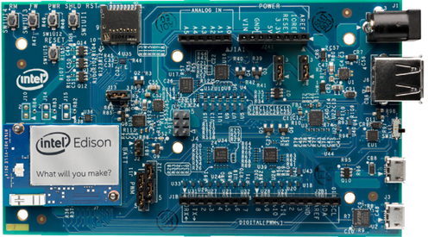
Intel Edison Development Boards: Arduino* expansion
Board I/O: Compatible with Arduino* Uno (except only 4 PWM instead of 6 PWM)
20 digital I/O pins including 4 pins as PWM outputs
6 analog inputs
1 UART (RX/TX)
1 I2C
1 ICSP 6-pin header (SPI)
Micro USB device connector
Micro USB device (connected to UART)
SD Card connector
DC power jack (7V – 15V DC input)
Board to board Press-fit connection (Hirose DF40)
* Names and brands may be claimed by the property of third party name and the notation.
Notes:
Source –IDF
$90

Slide 8
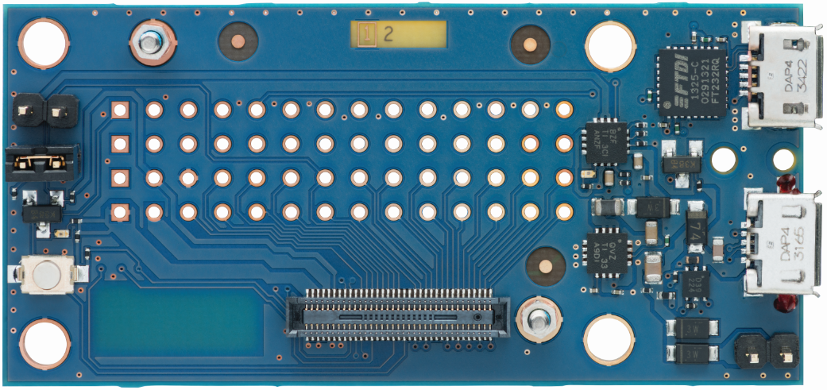
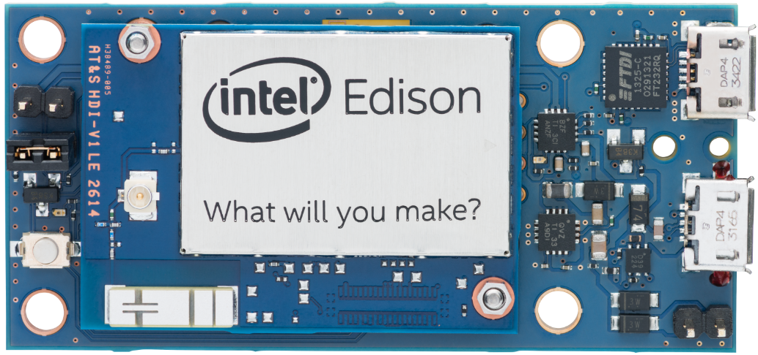
Intel Edison Development Boards: Breakout board
61mm x 29mm x 12mm (2.4 x 1.1 x 0.5 inches)
Board I/O:
Exposes native 1.8V I/O of the Edison module
0.1” grid I/O array of through-hole solder points
USB OTG with USB Micro Type-AB connector
USB OTG power switch
Battery Charger
USB to device UART bridge with USB Micro Type-B connector
Notes:
Source –IDF
$60
Sparkfun boards are also coming soon.

Slide 9
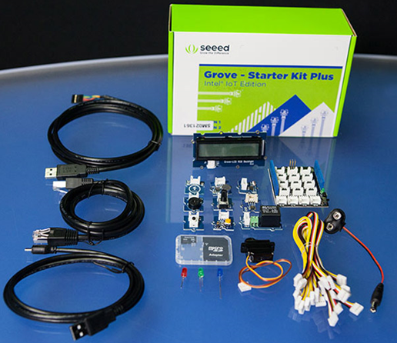
Grove* Starter Kit Plus - Intel IoT Edition
1 | Base Shield v2
2 | Grove - Buzzer V1.1
3 | Grove – Button
4 | Grove-LED v1.3
5 | Grove - Sound Sensor_V1.2
6 | Grove - Rotary Angle Sensor
7 | Grove-Touch Sensor
8 | Grove - Smart Relay
9 | Grove-Light Sensor
10 | Grove - Temperature Sensor_V1.1
11 | 26AWG Grove Cable
12 | Mini Servo
13 | 9V to Barrel Jack Adapter - 126mm
14 | DIP LED Blue-Blue
15 | DIP LED Green-Green
16 | DIP LED Red-Red
11 | Grove - LCD RGB Backlight
* Names and brands may be claimed by the property of third party name and the notation.

Slide 10

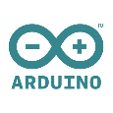
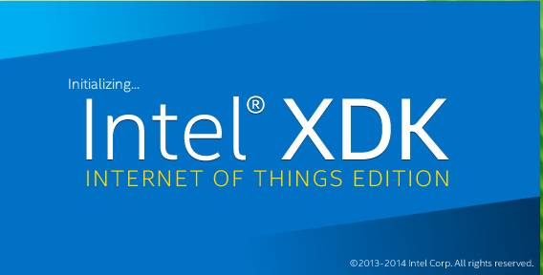


Target audience and developer path
Visual Developer
Arduino*
Developer
JavaScript
Developer
C / C++
Developer
Wind River
(Galileo only)
Target
Audience
Beginner
Maker
Intermediate
Advanced
Advanced
Professional
OS /
Boot Image
Yocto Project
Poky Linux*
Yocto Project
Poky Linux*
(SPI)
Yocto Project
Poky Linux*
Yocto Project
Poky Linux*
VxWorks*
Wyliodrin*
Web
Arduino* IDE
Win / Mac/ Linux
XDK
Win/ Mac/ Linux
Eclipse*
Win/ Mac / Linux
WR Eclipse*
Win / Linux
IDE
Dev Env
Programming
Language
Visual
Python
Arduino* Sketch
C++
JavaScript
(Node JS)
C/ C++
C / C++
Tools/ Libraries
Wyliodrin*
Arduino* Libraries
Intel® XDK
ISS
Work Bench / ISS
Cloud
IoT Cloud Analytics Widget
IoT Cloud Analytics
IoT Cloud Analytics
Mashery/ 3rd party
IoT Cloud Analytics
Mashery/ 3rd Party
WR Cloud
* Names and brands may be claimed by the property of third party name and the notation.
Notes:
Source – Daniel (CES/Roadshow)
Supporting various languages is biggest potential / strength.

Slide 11
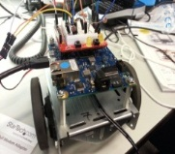
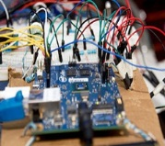

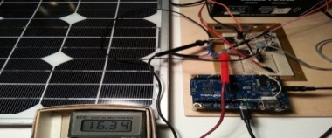
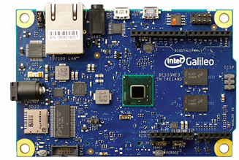
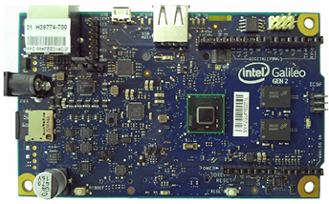
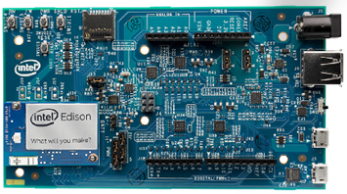
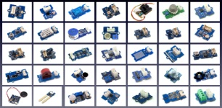
Intel® IoT Developer Kit
IoT Projects
A complete solution for creating IoT applications targeted for Intel® IoT platforms such as Intel® Galileo board and Intel® Edison board.
Wyliodrin* (Visual Programming)
Arduino* IDE
Intel® XDK IoT Edition
Eclipse*
+
ISS (optional)
Cloud Analytics / Mashery
IDE/ Tools
(Win, Mac, Linux)
Multiple IDEs (XDK, Eclipse, Wyliodrin*, Arduino*)
Cloud analytics & data management
Mashery IoT Restful APIs
Node JS Support
C/C++
Tool Chain
Wyliodrin*
Agent
IoT Cloud Agent
Multiple Programming Languages (JavaScript, C/C++, Arduino* Sketches, Visual programming)
S/W Image on IoT platform
UPM (Sensor/Actuator library repository)
APIs that shields H/W complexity (libmraa)
Sensor libraries with API bindings (UPM)
Libmraa
API Bindings C/C++, Node JS, Python
Open & Standard - Yocto Project Poky Linux* OS
Supports full range of Linux tools and libraries
Yocto Project Poky Linux* OS image (packages, drivers, tools, etc.)
Full x86 support (Scale from Intel® Quark™ SoC to Intel® Core™ processor)
Intel® Galileo (Gen1/ Gen 2), Intel® Edison
Hard Ware
Intel® Galileo
Gen 1
Intel® Galileo Gen 2
Intel® Edison
Sensors / Actuators
* Names and brands may be claimed by the property of third party name and the notation.
Notes:
Source –Ajay Mungara.
The Intel IoT Developer Kit caters to any IoT app developer, from novice to hobbyist to professional developers.
It combines the power and richness of x86 software with Arduino-style ease of hardware design.
It offers several development environments (from web base to command line); full Arduino support and interoperability; full-featured Linux software stack; out-of-the-box Cloud connectivity; and a plug-n-play setup procedure.
The DevKit’s universal base IO library allows to easily add support for hardware peripherals out of the box.
REST= Representational State Transfer

Slide 12
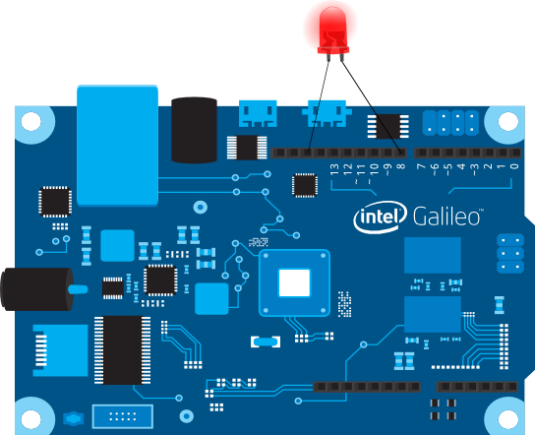

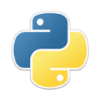
Python API
libmraa
I/O abstraction library to facilitate easy access to GPIO, I2C, SPI, PWM and UART
C API
mraa_gpio_context gpio; // Pointer to GPIO context
gpio = mraa_gpio_init(8); // Create GPIO context for pin 8
mraa_gpio_dir(gpio, MAA_GPIO_OUT); // Set GPIO direction to output
mraa_gpio_write(gpio, 1); // Write to GPIO
mraa_gpio_close(gpio); // Close GPIO if we are the owner
C++ API
Maa::Aio* a0;
a0 = new mraa::Aio(0); // Create AIO object for pin0
std::cout << a0->read() << std::endl;
JS (node.js) API
from mraa import * # Import mraa library
x = Gpio(8) # Create a GPIO object for pin 8
x.dir(DIR_OUT) # Set GPIO direction to output
x.write(1) # Write to GPIO
x = "memory is not my problem!"
var m = require("mraa") # Import mraa module
var x = new m.Gpio(8) # Create a GPIO object for pin 8
x.dir(m.DIR_OUT) # Set GPIO direction to output
x.write(1) # Write to GPIO
12
* Names and brands may be claimed by the property of third party name and the notation.
Notes:
Source –Brendan
C API
Base API works on the concept of 'contexts'
C++ API
Header only library
'contexts' are represented by Objects
JS (node.js) API
Generated from C++ API using SWIG 3.x
node.js 0.10.x minimum
Python API
Generated from C++ API using SWIG
Python 2 & 3 compatible
Platforms are detected using a C constructor
getPlatformType() // mraa_get_platform_type()
getPlatformName() // mraa_get_platform_name()
You don't link against a board, the API is completely arch/board specific
Exception is x86 builds don't include arm or mips platform code
Platform config can be queried but is 'read only'
Logging is done via syslog, pretty verbose when stuff goes wrong
Platforms are defined using the pinmapper, which supports using muxes etc… but can include hooks for platforms that require 'special' functions.
Contexts can be initialised in 'raw' mode, meaning we ignore the pinmapper and use the kernel's numbering, used internally but can be useful for debugging & unsupported platforms
More info: http://iotdk.intel.com/docs/master/mraa/internals.html

Slide 13
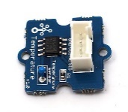
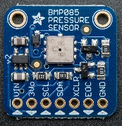
UPM (Useful Packages for Mraa)
Sensor library using libmraa for easy sensor access
Example of UPM Modules
Temperature Sensor
// Create the temperature sensor object using AIO pin 0
upm::GroveTemp* temp = new upm::GroveTemp(0);
// Print the value of temprature reading in deg. centigrade
std::cout << temp->value() << std::endl;
Atmospheric Pressure Sensor
// Create an object of type GY65(bmp085) on i2c bus 0
upm::GY65 *sensor = new upm::GY65(0, 0x77);
//print temp. pressure & Altitude
std::cout << sensor->getTemperature()<< std::endl;
std::cout << sensor->getPressure() << std::endl;
std::cout << sensor->getAltitude()<< std::endl;
13
Notes:
Source –Brendan
UPM provides not specific API, simply a style and a namespace.
80+ sensor
UPM is a high-level repository of sensor representations, written in C++, utilizing the MRAA library. Certain sensors have a corresponding class in UPM, offering an object representation of this sensor and some useful functions specific to that sensor.
It is made of multiple C++ and/or C libraries that are individually linked to libmraa
It includes all the correct build wrappers for sensor manufacturer and/or the community to be able to easily extend and add sensors
It will be maintained by Intel and follow the github workflow (fork, commit, pull request, review, merge)

Slide 14
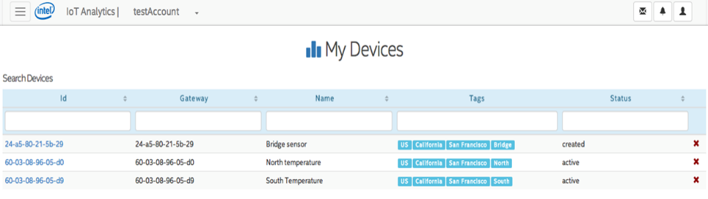

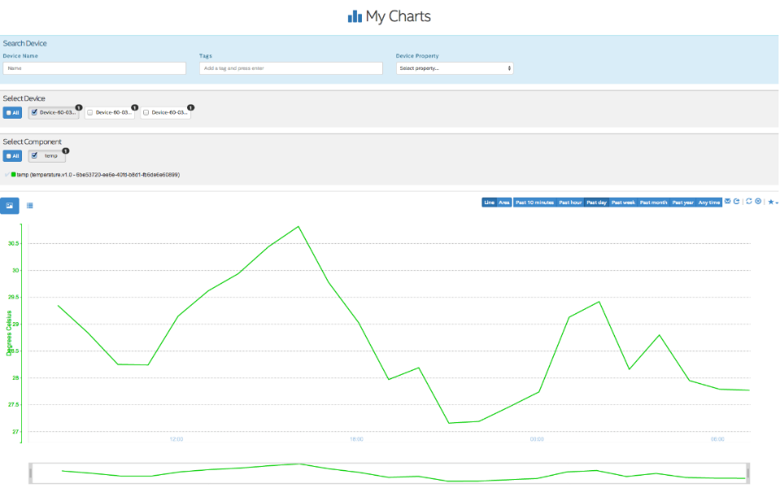



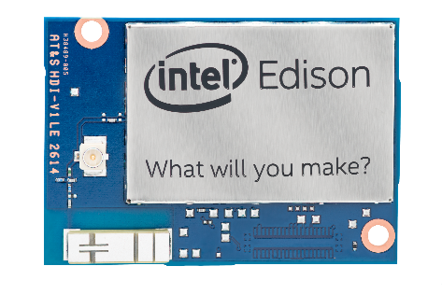




Intel® IoT Analytics - www.enableiot.com
RESTful API
iotkit-agent (UDP / TCP)
#! /usr/bin/env python import socket import sys
UDP_PORT = 41234 sock = socket.socket(socket.AF_INET, socket.SOCK_DGRAM)
sock.sendto('{"n":"' + component + ‘","v":"' + value + '"}', ('localhost', UDP_PORT))
Notes:
Source –Matthias
REST – Representational State Transfer
Resource based, Representations, constraints.

Slide 15

Resources
Intel® Edison: http://www.intel.com/content/www/us/en/do-it-yourself/edison.html
IoT Developer Zone : https://software.intel.com/en-us/iot
libmraa: https://github.com/intel-iot-devkit/mraa
UPM: https://github.com/intel-iot-devkit/upm
Documentation:
Libmraa: http://iotdk.intel.com/docs/master/mraa/
UPM: http://iotdk.intel.com/docs/master/upm
NodeJS: https://www.npmjs.org/package/mraa
Python: http://iotdk.intel.com/docs/master/mraa/python
Cloud Analytics: https://software.intel.com/en-us/intel-iot-developer-kit-cloud-based-analytics-user-guide
15
Notes:
Attribution: Resource image: corelaborate.psesd.org

Slide 16


Next steps
Visit Hackfest Github: https://github.com/srware/wearable_technology_show_2015
Develop & exhibit your demo - your IoT/ Wearable solution should be:
Innovative
Business viable / sustainable.
Using Intel® Edison key features (performance, Wi-Fi / BTLE connectivity, small size).
Wed-11-Mar @ 15:00 every team will get 5 minutes to exhibit the demo.
Win awesome prizes Wed-11-Mar ~16:00  
16
Notes:
Attribution : Good luck image www.kendalrugby.co.uk 1357736064_0.jpg,
Call to action image www.bluecowcreative.ca call-to-action.jpg

Slide 17
We’d Love To See You Again…Maker Fairs/Hackfests
Event | When | Where
Make ‘n’ break Hackathon | 28-29 March | Bucharest
Maker Faire Paris | 2-3 May | Paris
Maker Fare Dublin | 25 July | Dublin
Maker Faire Rome | 16-18 October | Rome
CodeMotion | 9-12 April | Milan
Notes:
Source – Gail Hanlon

Slide 18
We’d Love To See You Again…IoT Events
Event | When | Where
Intel IoT Roadshow | Mar 14 - 15 | Milan
CeBIT | Mar 16 - 20 | Hannover
Internet of Things Conference | Mar 23 - 26 | Hannover
Machine to Machine and Objets Connecte | 1 – 2 April | La Defense, Paris
Intel IoT Roadshow | June 12 – 13 | London
Hannover Messe | April 13-17 | Hannover
Notes:
Source – Gail Hanlon

Slide 19
Thanks!

Slide 20
Backup

Slide 21
IoT DevKit for Edison vs. Galileo
Intel® Edison
Unified OS Image
Intel® Galileo Gen 1/Gen 2
Independent OS Image
OS/ Image
S/W package for Edison
EGLibC OS Image (Yocto 1.6)
libMraa/ UPM
Access to low-level I/O + Sensor libs -Included in Intel® Edison S/W stack
Access to low-level I/O + Sensor libs
C/C++ (Eclipse)
C/C++ tool chain. Eclipse IDE (64-bit) for C/C++ dev on Win, Linux, Mac
C/C++ tool chain. Eclipse IDE (64-bit) for C/C++ dev on Win, Linux, Mac
Node JS Support. XDK IoT Edison
(Sept 30th )
Node JS Support. Intel® XDK IoT Edition
(Sept 30th )
Java script (XDK)
Visual (Wyliodrin*)
Wyliodrin* Component
Wyliodrin* Component
Arduino™
Included in Edison S/W stack
Multi-lib support for Arduino™
VxWorks*
Future
Vx Works* + Work bench*
Intel® System Studio
Advanced optimization tools for IoT
Advanced optimization tools for IoT
IoT Cloud Analytics
IoT Cloud Analytics component
- Included in Intel® Edison S/W stack
IoT Cloud Analytics component
* Names and brands may be claimed by the property of third party name and the notation.

Slide 22
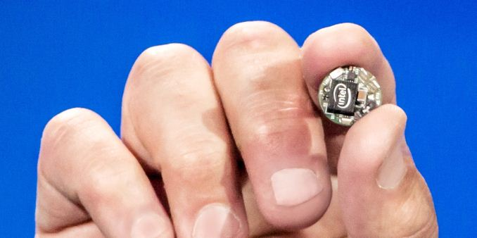
Upcoming… Intel® Curie™ module
The Intel® Quark™ SE SoC is the purpose-built designed for Wearables
Highly integrated tiny low-power and intelligent solution for wearable space.
Board I/O: Battery charging circuitry (PMIC)
MCU: 32-bit Intel® Quark™ microcontroller
SRAM: 80kB
Flash: 384kB
Bluetooth: Low Energy
Sensors: Integrated DSP sensor hub with pattern matching 6-axis combo sensor (accelerometer and gyroscope)
OS: Open Source Real-Time OS
Apps: Intel® IQ Software Kits
Schedule: Second Half 2015
* Intel, the Intel logo, Quark and Curie are trademarks of Intel Corporation in the U.S. and/or other countries.
Notes:
In the future, we will see wearable products created by companies that have historically never used silicon before…
It’s now up to the ecosystem to innovate with this technology; rings, bags, bracelets, pendants and yes, buttons, will all be possible.”
This SoC is ideal for “always-on” applications such as social notifications and sports activities.
Intel® IQ Software Kits include the embedded software that runs on the module together with companion smartphone applications and associated cloud capabilities

